Slide 1
HIGH ENOUGH? EXPLAINING AND PREDICTING TRAVELER SATISFACTION USING AIRLINE REVIEWS
Presented By:
Shubho Chandra shil
ID: UG02-48-18-021

Slide 2
INTRODUCTION
Air travel is one of the most frequently used means of transportation in our everyday life. In the last decades, air travel has become one of the most frequently used means of transportation.
Thus, it is not surprising that an increasing number of travelers share their experiences with airlines and airports in form of online reviews on the Web. In this work, we thrive to explain and uncover the features of airline reviews that contribute most to traveler satisfaction.
Each review category consists of several five-star ratings as well as free-text review content.

Slide 3
KEYWORDS
Airlines reviews
Skytrax
Traveler satisfaction
User satisfaction prediction
Advantage and Disadvantages
Features analysis

Slide 4
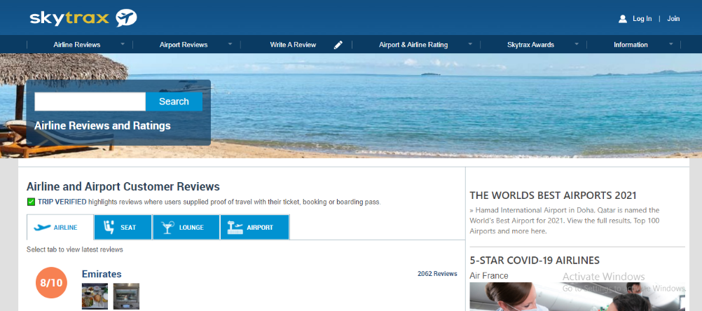
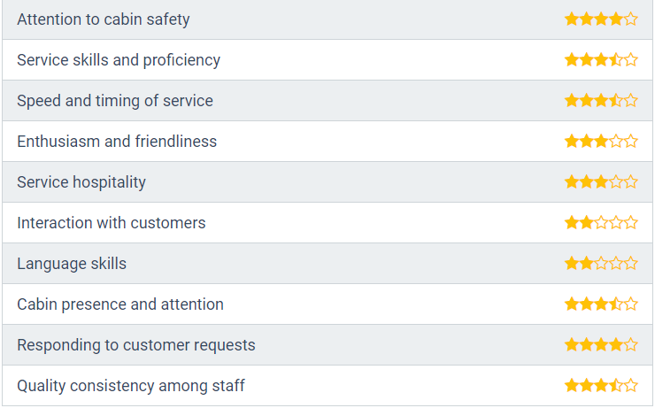
AIRLINES REVIEW
Reviews
Ratings
RQ1: Which airline review features are most indicative for traveler satisfaction?
RQ2: To what extent can we predict traveler satisfaction using the available rating and
inferred sentiment of airline reviews?

Slide 5
SKYTRAX
Skytrax, the international air transport rating organization, was established in 1989, and is based in London, UK.
Introduce in 1999, the world Airline and Airport Star Rating Program.
New Update
In August 2020, Skytrax launched the COVID-19 safety ratings covering airlines and airports across the world.

Slide 6
EXPLAINING TRAVELER SATISFACTION AND METHODOLOGY
We use the overall rating to evaluate how the different review features influence the traveler’s satisfaction.
Overall scores
Rating and inferred features with the overall ratings by user
Reviews on Airport, Lounge, Airlines and Seat.

Slide 7
PREDICTING TRAVELER SATISFACTION AND METHODOLOGY:
Formulate the task a binary classification problem.
Given reviews marked as either positive or negative satisfaction.
In this work, however, we report the results of the
Hoeffding Tree.
We chose this algorithm due to its practical advantage for real-time
data mining.

Slide 8
METHODOLOGY
To determine the best performing features for traveler satisfaction prediction, we trained and evaluated the classification model in the following three settings.
1. for each single rating feature, we created a separate classifier and evaluated its performance.
2. we used a combination of features that highly correlate with the traveler satisfaction while having a low inter-correlation
3. we trained a model solely based on the inferred review text sentiment.

Slide 9
ADVANTAGES OF AIRLINE REVIEWS:
1.World's best Airlines.
2.The services of the airlines.
3.Latest airports reviews.
4.Customer travelling Satisfaction.
5.All Classes of latest lounge .
6.COVID safe travelling.
7.Ratting of all classes seats.

Slide 10
DISADVANTAGE OF AIRLINE REVIEWS:
1.Going Through Security.
2.Cramped Economy Flights.
3.Traveler can't carry any food.
4.Expensive Airports.
5.Delays, Cancellations, and Lost Baggage.
6.Passports, Bureaucracy, and Luggage Collection.
7.Traveling To and From the Airport.
8.Traveler can't fixed the time schedule.
9. Inconsiderate and Noisy Neighbors .

Slide 11
CONCLUSION
In this paper, we discuss how online reviews can be an important source of information to explain (RQ1) and predict (RQ2) traveler satisfaction. We utilized data crawled from the Skytrax portal in order to show that rating features such as airport queuing time, lounge comfort, airline cabin staff quality and seat legroom size highly contribute to the overall traveler satisfaction.
Based on these findings, we trained several classifiers and we report the results of the Hoeffding Tree algorithm. The algorithm is especially suited for real-world settings, where the goal is to continuously mine and predict traveler satisfaction using online reviews.

Slide 12
Thank You

